Slide 1
Cortana Intelligence Suite
Technical overview
Notes:
Hi, I’m ___, and I’m excited to discuss Microsoft’s Cortana Intelligence Suite, and the value it can deliver to your organization.

Slide 2
Business is being transformed by three trends
Big Data
Cloud
Intelligence
Notes:
Today, the world around us is rapidly changing, faster than at any other point in history. This is an indicator of the fourth industrial revolution that is emerging, largely driven by the rise of Big Data, the growth of the cloud, and a new era of intelligence capabilities.
Thanks to the exponential proliferation of small, inexpensive chips and processors, computers are as ubiquitous as the people who use them – from traditional computers, tablets and phones to sensors and wearables. Machines are everywhere, constantly creating, collecting and making sense of the data in our midst. With the magic of machine learning and the limitless computing power of the cloud, this data is giving rise to intelligence that is augmenting human capabilities in exciting new ways.
Together, these technologies have the power to disrupt almost every industry, which is why this era is being heralded as the fourth industrial revolution. The breadth and depth of these changes is resulting in the transformation of entire systems of production, management, and governance.
At Microsoft, our ambition is to democratize the fourth industrial revolution by providing the building blocks to empower organizations large & small – enabling them to build, innovate and transform, and allowing them to get started quickly and see real business impact and results fast. We believe an organization’s data is a key strategic asset which, when combined with the cloud and the potential of intelligence capabilities, provides the opportunity to automate, innovate and increase the speed of business.
<Transition>: Our Cortana Intelligence Suite is designed to help you capitalize on these trends.

Slide 3



Stay ahead of the curve with Cortana Intelligence Suite
Business apps
People
Custom apps
Apps
Sensors and devices
Cortana Intelligence
Automated systems
Data
Intelligence
Action
Notes:
Cortana Intelligence is Microsoft’s fully managed intelligent, big data and advanced analytics offering in the cloud, designed to help you transform your data into intelligent action.
It is a comprehensive suite that brings together technologies throughout Microsoft. It provides fast and flexible deployment, with a simple monthly subscription to reduce time and cost challenges.
Cortana Intelligence enables customers to benefit from Microsoft’s investment in the intelligent cloud and advanced analytics, spanning our leading cloud platform with easy to use tools and services that integrate with existing infrastructure and enable enterprises to extend business solutions as their needs grow over time.
With Cortana Intelligence, we are taking years of research and innovation – spanning technology & infrastructure for advanced analytics, including capabilities such as machine learning, big data storage and processing in the cloud, intelligence capabilities like vision, face and speech recognition, and integration with Cortana, Microsoft’s personal digital assistant, with the goal of helping enterprise customers make better, faster decisions to accelerate their speed of business.
<Transition>: Let’s talk about how some of our customers are benefiting from Cortana Intelligence.

Slide 4
Here are some examples of how our customers are staying ahead
Improving visibility and making accurate predictions with remote monitoring
Getting the right products to the right places with inventory management
Offering customers exactly what they want, when they want it, with personalization
Fixing problems proactively before they start with predictive maintenance
Exploring new business opportunities with data-driven services
Notes:
<Speaker guidance: You may choose to use this slide, or one of the 2 hidden slides that follow it. The point of all 3 slides is the same – give examples of ways that customers are using Big Data, cloud and intelligence to transform their businesses, as a lead-in to a demo>
Getting ahead by leveraging Big Data, the cloud and intelligence can take a number of forms.
It starts with understanding the data your organization has and what it can be used for.
There are several core business scenarios where our customers are finding great success with Microsoft technologies.
These can be a useful starting point as you consider how your organization could benefit.
Here are a few examples of what our customers are doing to stay ahead:
Using remote monitoring to gain better visibility into their businesses and making better predictions regarding their customers’ needs
Improving inventory management by using predictive analytics capabilities to ensure inventory is optimally distributed to the right places at the right times
Offering customers personalized experiences using advanced analytics to develop deep, 360-degree view of their customers
Starting predictive maintenance programs to fix problems proactively, before equipment ever breaks down
Building data-driven service offerings, such as delivering products-as-services or packaging data for commercial sale
Other examples include real-time recommendations, customer churn forecasting, fraud detection, and many more.
<Transition>: Let’s take a look at one example.

Slide 5
Here are some examples of how our customers are staying ahead
Improving visibility and making accurate predictions
Getting the right products to the right places
Offering customers exactly what they want, when they want it
Fixing problems proactively before they start
Exploring new business opportunities
Remote monitoring
Demand forecasting
Risk and compliance management
Inventory management
Supply chain optimization
Marketing mix optimization
Personalized offers
Product recommendations
New product introduction
Predictive maintenance
Operational efficiency
Customer service improvement
Cross-sell and upsell
Product-as- a-service
New data- driven services
Notes:
<Speaker guidance: You may choose to use this slide, the slide before, or the slide after. The point of all 3 slides is the same – give examples of ways that customers are using Big Data, cloud and intelligence to transform their businesses, as a lead-in to a demo>
Getting ahead by leveraging Big Data, the cloud and intelligence can take a number of forms.
It starts with understanding the data your organization has and what it can be used for.
There are several core business scenarios where our customers are finding great success with Microsoft technologies. These can be a useful starting point as you consider how your organization could benefit.
Here are a few examples of what our customers are doing to stay ahead:
They are gaining better visibility into their businesses and making better predictions
In manufacturing, this can involve using remote monitoring to know exactly what’s going on with equipment at customer sites or in remote locations
In retail, this involves optimizing demand forecasting to better predict what customer demand will look like next season, or next year.
In financial services or other areas where risk-mitigation is needed, it might involve pinpointing signs of fraud more effectively
They are using advanced analytics to ensure materials, parts and products are optimally distributed to the right places at the right times
In manufacturing, this may involve optimizing the supply chain, making sure parts are on hand in the right warehouses and at the right suppliers given historical patterns
In retail, this involves more precisely managing inventory and ensuring it goes to the right place the first time, which preserves margins by reducing the need to ship inventory elsewhere. If a customer looks at a product online, then comes into a store to purchase it, the retailer can have advance warning and be prepared with the item in stock (or know where it is in a nearby store)
These are both examples of better optimizing the marketing mix – using advanced analytics and intelligence to ensure the right product is in the right place, at the right price
Across industries, getting the right items to the right places contributes to operational efficiency objectives
Offering customers what they want, when they want it, using advanced analytics to develop deep, 360-degree view of customers and deliver personalized experiences
In manufacturing, this may involve tracking a customer’s use of a particular product, identifying wear patterns, offering advice on how to make the product last longer, and offering targeted promotions on replacement parts. This enables manufacturers to anticipate what customers need before they even ask.
In retail, this can involve tracking every customer interaction and purchase, whether in-store, online, via social media, via a mobile app or other channels. Assembling a picture of the customer in this way helps retailers better predict what customers are looking for, and can offer targeted promotions and offers.
In financial services, this might involve making more tailored product recommendations based on customer information from across channels - from detailed demographics to social media interactions.
Across industries, using data, advanced analytics and intelligence capabilities can support more successful new product introduction. With these technologies, you can reduce the likelihood of introducing products that flop by informing product development with data and analytics.
Fixing problems proactively, before products and equipment ever break down
Across many industries, this can involve starting predictive maintenance programs – whether that’s for your own equipment, assets or facilities, or for products installed at customer sites
Across many industries, getting problems proactively handled can support operational efficiency gains – it’s usually cheaper, faster and easier to prevent a problem than to fix it after the fact. Whether you’re talking about chronic disease care or expensive equipment at a manufacturing site, the principle is the same.
Across many industries, customer service improvement as a result of advanced analytics and big data is an example of fixing problems proactively before they start. For example, if you’re a cable provider, and you know there have been service quality problems for a certain customer, you can proactively, automatically offer them a discount, and notify them that you are working on the problem, and offer a target resolution time. This could prevent them from calling into your call center multiple times, and may even prevent them from switching to another firm.
Building data-driven service offerings, such as delivering products-as-services or packaging data for commercial sale
In any industry offering physical products, this might involve offering products as services. Instead of a single transaction where a product is exchanged, the product is automatically serviced and updated, maintaining the relationship with the customer and creating opportunities for cross-sell and upsell.
In manufacturing, using advanced analytics and big data to identify typical wear patterns and next-logical-purchases, firms can offer targeted promotions on replacement parts as well as complementary products
These are just a few of the many examples out there. Other examples include real-time recommendations, better customer acquisition, optimized loyalty programs and lifetime customer value, customer churn forecasting, fraud detection, pay for performance, more accurate product segmentation, better pricing strategies and many more.
<Transition>: Let’s take a look at one example.

Slide 6
No matter your industry, Microsoft technologies can help you stay ahead
Retail
Manufacturing
Financial Services
Health
Government
Real Time Offers & Personalized Services
Demand Forecasting
Sentiment Analysis
Manufacturing Ops
Connected Cars
Customer Experience
Risk Assessment
Remote Health Monitoring
Population Health Management
Smart Buildings
Transit & Traffic Optimization
Notes:
<Speaker guidance: You may choose to use this slide, or one of the two slides before it. The point of all 3 slides is the same – give examples of ways that customers are using Big Data, cloud and intelligence to transform their businesses, as a lead-in to a demo>
Getting ahead by leveraging Big Data, the cloud and intelligence can take a number of forms.
It starts with understanding the data your organization has and what it can be used for.
That said, there are some core business scenarios where our customers in many industries seeing promising results.
These can be a useful starting point as you consider how your organization can benefit.
<Transition>: Let’s take a look at one example.
Retail:
JJ Foods (UK) – https://customers.microsoft.com/Pages/CustomerStory.aspx?recid=18352
Wirtz Beverage (US) - http://customers.microsoft.com/Pages/CustomerStory.aspx?recid=10760
Manufacturing:
eSmart Systems: https://customers.microsoft.com/Pages/CustomerStory.aspx?recid=18945
ThyssenKrupp: https://microsoft.sharepoint.com/sites/academy/media/Catalog/AEVD-3-99448
Healthcare
Dartmouth-Hitchcock: https://youtu.be/x1XARd8Xo7M

Slide 7



Dartmouth-Hitchcock Demo + Video
Notes:
Video: https://youtu.be/x1XARd8Xo7M
https://www.youtube.com/watch?v=-wVeHZNn8aU
Demo assets: http://infopedia/SMSG/Pages/MDWHadoop.aspx?ebookNode=Hadoop&SourceURL=http://infopedia/Pages/SQL-Server-ModernDataWarehouse.aspx
Cortana Intelligence enables core business scenarios such as real-time recommendations, customer churn forecasting, fraud detection, predictive maintenance and many more.
For e.g. we are working with Dartmouth-Hitchcock Medical Center, the largest hospital in northern New England, to develop a remote monitoring and predictive analytics solution to lower re-admittance rates called “ImagineCare.” Leveraging predictive analytics, ImagineCare will be to enable dynamic treatment plans based on the individual patient’s history and profile. ImagineCare aims to significantly enhance patient outcomes by predicting catastrophic events such as, heart attacks before they happen.
It will also reduce the number of “readmissions” because each patient will be proactively monitored and Dartmouth-Hitchcock can contact the patient with tweaks/recommendations to the individual’s pathway based on the data collected.
Other customers who are using Cortana Intelligence capabilities include:
Pier 1 https://customers.microsoft.com/Pages/CustomerStory.aspx?recid=11257
Carnegie Mellon https://customers.microsoft.com/Pages/CustomerStory.aspx?recid=8576
Wash https://customers.microsoft.com/Pages/CustomerStory.aspx?recid=11768
Stanford Linear Accelerator https://news.microsoft.com/features/from-atoms-to-quarks-to-the-cosmos-internet-of-things-helps-lab-explore-the-origins-of-the-universe/
Ziosk http://news.microsoft.com/features/tabletop-tablets-provide-a-better-experience-for-diners-and-valuable-data-for-restaurants/
Genscape https://customers.microsoft.com/Pages/CustomerStory.aspx?recid=21394

Slide 8
How can Cortana Intelligence help you?
Notes:
That was just one example of how Cortana Intelligence helped one business solve key data issues.
T: Now, lets dive into what makes up the suite, and how these services can help you.

Slide 9
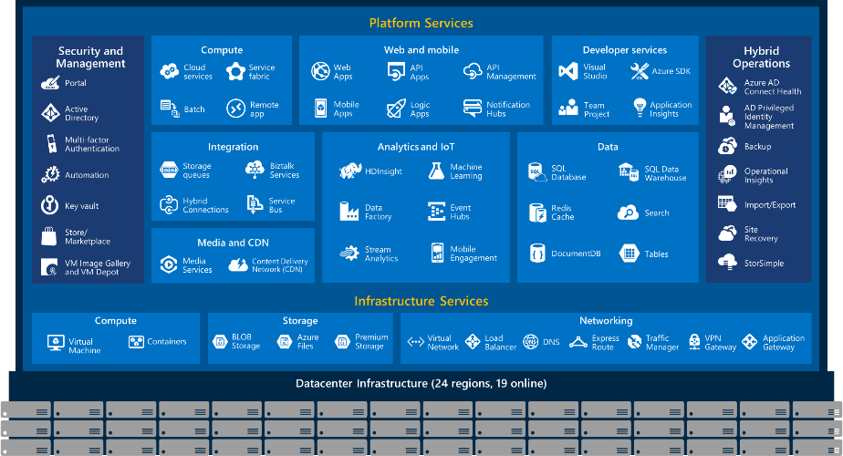
Cortana Intelligence combines the services you already know
Notes:
Here you will find an overview of all of the services that Microsoft has to offer.
The solutions that you may be familiar with, highlighted in GREEN, are elements included in Cortana Intelligence.
T: Let’s take a look at the whole architecture.

Slide 10






Transform data into intelligent action
Information Management
Big Data Stores
Machine Learning and Analytics
Intelligence
People
Data Sources
Data Factory
Data Lake Store
Machine Learning
Cognitive Services
Data Catalog
SQL Data
Warehouse
Data Lake Analytics
Bot Framework
Web
Apps
HDInsight
(Hadoop and Spark)
Mobile
Event Hubs
Blob Storage
Cortana
Apps
Bots
Sensors and devices
IoT Hubs
Cosmos DB
Stream Analytics
Dashboards & Visualizations
Automated Systems
Power BI
Data
Data
Intelligence
Action
Notes:
T: Cortana Intelligence provides everything you need to transform your organization’s data into intelligent action. Next, let’s take a look at another demo.

Slide 11

Information Management
Information Management
Data Sources
Data Factory
Apps
Data Catalog
Event Hubs
Sensors and devices
Data
Notes:
T: Information Management includes Data Factory, Data Catalog, and Event Hubs.

Slide 12
Compose and orchestrate data services at scale
Information Management
SQL
Data Factory
INGEST
PREPARE
TRANSFORM & ANALYZE
PUBLISH
DATA SOURCES
SQL
SQL
DATA CONSUMPTION
<>
Data Catalog
Event Hubs
SQL
{ }
Create, schedule, orchestrate, and manage data pipelines
Visualize data lineage
Connect to on-premises and cloud data sources
Monitor data pipeline health
Automate cloud resource management
Move relational data for Hadoop processing
Transform with Hive, Pig, or custom code
Notes:
<click>
Data Factory is a globally deployed, fully managed data movement service in the cloud. It enables enterprises to ingest data from multiple on-premises and cloud sources easily, and gets your data where it needs to go. Prepare and partition your data as you ingest it, or apply pre-processing steps.
Data Factory allows enterprises to produce trusted data by easily composing, orchestrating, and monitoring diverse data, transformation and processing services at scale.
You can compose multiple data sources, on premises or in the cloud into highly available, fault tolerant, and streamlined data pipelines. You can process traditional relational data alongside data of different forms and velocities.
Data pipelines operate over the Hadoop ecosystem for transformations with Hive, Pig, and custom code, tying together your traditional relational data with features like automatic cluster management, retries for transient failures, configurable timeout policies, and alerting.
T: Lets look at the next service, Data Catalog
----
The Azure Data Factory service is a fully managed service for composing data storage, processing, and movement services into streamlined, scalable, and reliable data production pipelines. Developers can use Data Factory to transform semi-structured, unstructured and structured data from on-premises and cloud sources into trusted information. Developers build data-driven workflows (pipelines) that join, aggregate and transform data sourced from their on-premises, cloud-based and internet services, and set up complex data processing through simple JSON scripting. The Azure Data Factory service provides monitoring and management of these pipelines at a glance with a rich visual experience offered through the Azure Preview Portal. The information produced by pipelines can be easily consumed using BI and analytics tools, and other applications to reliably drive key business insights and decisions.

Slide 13

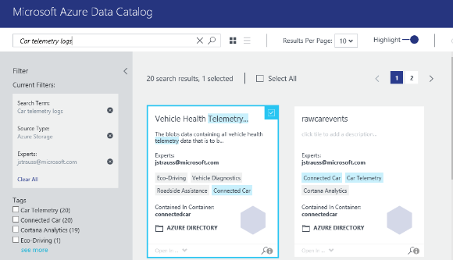
Get more value from your enterprise data assets
Information Management
Data Factory
Data Catalog
Event Hubs
Spend less time looking for data, and more time getting value from it
Register enterprise data sources, discover data assets and unlock their potential, and capture tribal knowledge to make data understandable
Bridge the gap between IT and the business, allowing everyone to contribute their insights, tags, and descriptions
Intuitive search and filtering to understand the data sources and their purpose
Let your data live where you want; connect using tools you choose
Integrate into existing tools and processes with open REST APIs
Notes:
In the new world of data, consumers of enterprise data spend more time looking for data than they do analyzing it. Azure Data Catalog is an enterprise-wide metadata catalog that makes data asset discovery trivial. It’s a fully managed service that lets any user—from analyst to data scientist to data developer—register, enrich, discover, understand, and consume data sources.
Azure Data Catalog is a fully managed service that serves as a system of registration and system of discovery for enterprise data sources. Azure Data Catalog provides capabilities that enable any user – from analysts to data scientists to developers – to register, discover, understand, and consume data sources.
Data Catalog brings huge value to data enrichment by allowing all users within an organization to add context to data. Not just the data scientists, anyone can use this system.
T: Let’s talk about Azure Event Hubs, an innovative data ingestion service.

Slide 14
Ingest events from websites, apps and devices at cloud scale
Information Management
Data sources
SQL Database
Machine Learning
Data Factory
Apps
Azure
API
Management
Data Catalog
Storage
HDInsight
Sensors and devices
Event Hubs
Event Hubs
Backend Services
Stream Analytics
Power BI
Data
Log millions of events per second in near real time
Connect devices using flexible authorization and throttling
Use time-based event buffering
Get a managed service with elastic scale
Get a managed service with elastic scale
Reach a broad set of platforms using native client libraries
Pluggable adapters for other cloud services
Notes:
Azure Event Hubs is a highly scalable publish-subscribe service optimized for reliably ingesting high volumes of data.
Event Hubs can process millions of events per second and stream them into multiple applications. This lets you analyze the massive amounts of data produced by your connected devices and applications. Once Event Hubs has collected the data, transform and store it by using any real-time analytics provider or with batching/storage adapters.
T: Cortana Intelligence take all of this data and stores it using Big Data storage technologies.
---
An application can benefit from Event hub when you have a large amount of data coming in, and at the same time, you need to process that large amount of data without risking any loss.
For example, you have a voice dictation application, and you collect the audio, and use a service bus to send it to windows, but have a lot of users. You would be better off using event hub and processing that data through stream analytics to sort the data, and from there route into whatever processing pipe you have set up. Because you need your user input and the feedback to be as quick as possible, while running analytics on the data, event hub will allow you to scale at the pace needed.

Slide 15
Big Data Stores
Information Management
Big Data Stores
Data Sources
Data Factory
Data Lake Store
Apps
Data Catalog
SQL Data
Warehouse
Event Hubs
Sensors and devices
Data
Notes:
T: Azure provides a variety of storage options, including Blobs. Here we’ll dive into the two main storage options with Cortana Intelligence, starting with Data Lake Store.

Slide 16



A hyper-scale repository for big data analytics workloads
Big Data Stores
Devices
Social
ADL Analytics
Data Lake Store
LOB Applications
Video
HDInsight
ADL Store
SQL Data
Warehouse
R
Web
Sensors
Spark
Relational
Clickstream
Machine Learning
A Hadoop Distributed File System for the cloud
No fixed limits on file size
No fixed limits on account size
Unstructured and structured data in their native format
Massive throughput to increase analytic performance
High durability, availability, and reliability
Azure Active Directory access control
Notes:
Your data are valuable assets to your organization and have both present and future value. Because of this, all data should be stored for future analysis. Today this is often not done because of the restrictions of traditional analytics infrastructure, like the pre-definition of schemas, the cost of storing large datasets, and the propagation of different data silos.
To address this challenge, the data lake concept was introduced as an enterprise-wide repository to store every type of data collected in a single place. For the purpose of operational and exploratory analytics, data of all types can be stored in a data lake prior to defining requirements or schema.
Microsoft Azure Data Lake Store is a Hadoop file system that’s compatible with Hadoop Distributed File System (HDFS) and works with the Hadoop ecosystem. Data Lake Store is integrated with Azure Data Lake Analytics and Azure HDInsight and will be integrated with Microsoft offerings like Revolution-R Enterprise; industry-standard distributions like Hortonworks, Cloudera, and MapR; and individual Hadoop projects like Spark, Storm, Flume, Sqoop, and Kafka.
Data Lake Store is a very open, massive scale data store designed for extremely high throughput and low latency for analytics workloads.
At the same time, its built-in security ensures you can include even your most critical workloads on it.
T: You may have noticed we are emphasizing these services are all built to scale, and SQL Data Warehouse is no different.

Slide 17
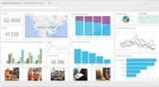
Elastic data warehouse as a service with enterprise-class features
Big Data Stores
Data Lake Store
Power BI
Hadoop
SQL Data
Warehouse
App Service
SQL Database
SQL Data Warehouse
Intelligent App
Machine Learning
Petabyte scale with massively parallel processing
Independent scaling of compute and storage—in seconds
Transact-SQL queries across relational and non-relational data
Full enterprise-class SQL Server experience
Works seamlessly with Power BI, Machine Learning, HDInsight, and Data Factory
Notes:
Historically, data warehouses have required fixed combinations of storage and compute, often underutilizing expensive resources. With Azure SQL Data Warehouse, storage and compute scale independently. You can dynamically deploy, grow, shrink, and even pause compute, taking advantage of best-in-class price/performance. Also, SQL Data Warehouse uses the power and familiarity of T-SQL to let you easily integrate query results across relational data in your data warehouse and non-relational data in Azure blob storage.
SQL Data Warehouse uses Microsoft’s massively parallel processing (MPP) architecture. You pay for time-to-insight, not hardware, based on performance objectives for fundamental data warehousing operations like scanning, loading, and query processing. SQL Data Warehouse uses SQL Server in-memory columnstore indexes and an advanced cost-based query optimizer to deliver optimal price/performance.
T: Next let’s look at Machine Learning and Analytics

Slide 18
Machine Learning and Analytics
Information Management
Big Data Stores
Machine Learning and Analytics
Data Sources
Data Lake Store
Machine Learning
Data Factory
SQL Data
Warehouse
Data Lake Analytics
Apps
Data Catalog
HDInsight
(Hadoop and Spark)
Event Hubs
Sensors and devices
Stream Analytics
Data
Intelligence
Notes:
T: Advanced analytics services are where data starts turning into insight that drives intelligent action.

Slide 19
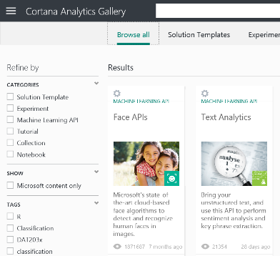
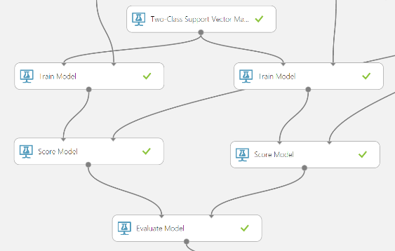
Easily build, deploy, and share predictive analytics solutions
Machine Learning and Analytics
Machine Learning
Data Lake Analytics
HDInsight
(Hadoop and Spark)
Stream Analytics
Simple, scalable, cutting edge. A fully managed cloud service that enables you to easily build, deploy, and share predictive analytics solutions.
Deploy in minutes. Azure Machine Learning means business. You can deploy your model into production as a web service that can be called from any device, anywhere and that can use any data source.
Publish, share, monetize. Share your solution with the world in the Gallery or on the Azure Marketplace.
Notes:
Azure Machine Learning is a fully managed cloud service that enables you to easily build, deploy, and share predictive analytics solutions.
You can deploy your model into production as a web service in minutes—a web service that can be called from any device, anywhere and that can use any data source.
You can also Share your solution with the world in the Gallery or on the Azure Marketplace.
We’ll get into more details about what Machine Learning can do in our demo later on.
T: Next is Data Lake Analytics.

Slide 20



Big data analytics made easy
Machine Learning and Analytics
Machine Learning
Data Lake Analytics
Data Lake Analytics
HDInsight
(Hadoop and Spark)
SQL DW
SQL DB
Data Lake Store
Storage Blobs
SQL DB in a VM
Stream Analytics
Analyze data of any kind and size
Develop faster, debug and optimize smarter
Interactively explore patterns in your data
No learning curve—use U-SQL, Spark, Hive, HBase and Storm
Managed and supported with an enterprise-grade SLA
Dynamically scales to match your business priorities
Enterprise-grade security with Azure Active Directory
Built on YARN, designed for the cloud
Notes:
Azure Data Lake Analytics is a new distributed service in the Azure Data Lake. We built Azure Data Lake Analytics from the ground up for cloud scale and performance. Data Lake Analytics makes the complex task of managing distributed infrastructure and complex code easy. It dynamically provisions resources and lets you do analytics on exabytes of data. When the job completes, it winds down resources automatically, and you pay only for the processing power used. As you increase or decrease the size of data stored or the amount of compute used, you don’t have to rewrite code. This lets you focus on your business logic only and not on how to process and store large datasets. It also takes away the complexities normally associated with big data in the cloud and ensures that Data Lake will meet your current and future business needs.
Azure Data Lake is the only solution that uses U-SQL, A powerful new language that brings the best of SQL and C# together with open source capabilities like Hive or Spark.
It is built for cloud scale and performance, it’s managed and it’s easy to set up. It seamlessly integrates with existing systems to make you productive from day one.
T: Next, let’s discuss HDInsight.

Slide 21
Comprehensive set of managed Apache big data projects
Machine Learning and Analytics
Batch
Map Reduce
Script
Pig
SQL
Hive
NoSQL
HBase
Streaming
Storm
In-Memory
Spark
Machine Learning
Data Lake Analytics
HDInsight
(Hadoop and Spark)
Core Engine
Stream Analytics
Scale to petabytes on demand
Process unstructured and semi-structured data
Develop in Java, .NET, and more
Skip buying and maintaining hardware
Deploy in Windows or Linux
Spin up an Apache Hadoop cluster in minutes
Visualize your Hadoop data in Excel
Easily integrate on-premises Hadoop clusters
Notes:
Azure HDInsight is an Apache Hadoop distribution powered by the cloud. This means that it handles any amount of data, scaling from terabytes to petabytes on demand. Spin up any number of nodes at any time. We charge only for the compute and storage that you use.
Because it's 100 percent Apache Hadoop, HDInsight can process unstructured or semi-structured data from web clickstreams, social media, server logs, devices and sensors, and more. This lets you analyze new sets of data and uncover new business possibilities that drive your organization forward.
HDInsight has powerful programming extensions for languages including C#, Java, and.NET. Use your programming language of choice on Hadoop to create, configure, submit, and monitor Hadoop jobs. With HDInsight, deploy Hadoop in the cloud without buying new hardware or incurring other up-front costs. There’s also no time-consuming installation or set up. Azure does it for you. Launch your first cluster in minutes.
Because it's integrated with Excel, HDInsight lets you visualize and analyze your Hadoop data in compelling new ways using a tool that's familiar to your business users. From Excel, users can select HDInsight as a data source. HDInsight is also integrated with Hortonworks Data Platform, letting you move Hadoop data from an on-site datacenter to the Azure cloud for backup, Dev/Test, and cloud-bursting scenarios. Using the Microsoft Analytics Platform System, you can even query your on-premises and cloud-based Hadoop clusters at the same time.
T: Next up is Azure Stream Analytics

Slide 22
Real-time stream processing in the cloud
Machine Learning and Analytics
SQL Database
Machine Learning
Event Hubs
Blob Storage
Event Hubs
Data Lake Analytics
Stream Analytics
Table Storage
HDInsight
(Hadoop and Spark)
Blob Storage
Power BI
Stream Analytics
Perform real-time analytics for your Internet of Things solutions
Stream millions of events per second
Get mission-critical reliability and performance with predictable results
Create real-time dashboards and alerts over data from devices and applications
Correlate across multiple streams of data
Use familiar SQL-based language for rapid development
Notes:
Azure Stream Analytics lets you rapidly develop and deploy low-cost solutions to gain real-time insights from streaming data from devices, sensors, infrastructure, and applications. Use it for Internet of Things (IoT) scenarios, such as real-time remote management and monitoring or gaining insights from devices like mobile phones and connected cars.
With every device, service, and process becoming a data point, the problem can often be analyzing and acting on data fast enough. Stream Analytics is easy to deploy, and simple to develop for, a low cost end to end event stream processing solution, that scales on demand.
Use fewer lines of code with built in analysis processes. Combine Stream Analytics with Event Hubs to analyze millions of points of data in a reliable environment.
T: Next, we’ll take a look at a demo that illustrates the value of the intelligence capabilities that Cortana Intelligence offers.

Slide 23
Demo
Notes:
www.how-old.net
T: Now we’ll dive deeper into the intelligence capabilities that truly set Cortana Intelligence apart.

Slide 24
Intelligence
Information Management
Big Data Stores
Machine Learning and Analytics
Intelligence
Data Sources
Data Lake Store
Machine Learning
Cognitive Services
Data Factory
Bot Framework
SQL Data
Warehouse
Data Lake Analytics
Apps
Data Catalog
Cortana
HDInsight
(Hadoop and Spark)
Event Hubs
Sensors and devices
Stream Analytics
Data
Notes:
T: Our intelligence capabilities fall into three areas – Cognitive Services, Bot Framework and Cortana.

Slide 25




Build applications that understand people
Intelligence
Vision
Speech
Language
Knowledge
Search
Cognitive Services
Computer Vision
Speaker Recognition
Text Analytics
Academic Knowledge
Bing Search API
Bot Framework
Face
Speech
Bing Speller
Entity Linking Service
Bing Image Search API
Cortana
Emotion
CRIS
Web Language Model
Knowledge Exploration Service
Bing Video Search API
Video
Linguistic Analysis
Recommendations
Bing News Search API
Language Understanding Intelligent Service
Bing Auto Suggest API
Faces, images, emotion recognition and video intelligence
Spoken language processing, speaker recognition, custom speech recognition
Natural language processing, sentiment and topics analysis, spelling errors
Complex tasks processing, knowledge exploration, intelligent recommendations
Bing engine capabilities for Web, Autosuggest, Image, Video and News
Notes:
What’s incredibly unique is the intelligence capabilities Cortana Intelligence offers, building on years of Microsoft research and innovation. These capabilities enable our customers to build intelligent systems and agents that can augment their organizational capabilities. For example, organizations can interact with customers and stakeholders in new ways and infer intent with vision, face, speech, text and sentiment analysis to customize responses and drive appropriate actions.
Microsoft Cognitive Services, a set of cloud services, APIs and SDKs that enable organizations to build intelligent systems that can see, hear, interpret and understand the world around you and makes all applications more intelligent, engaging and discoverable. Cognitive Services expands the existing perceptual intelligence capabilities like Vision, Speech, Text and Face detection to include new cognitive capabilities such as Emotion and customized Language Understanding. What we showcased with www.how-old.net is one example of what is possible.
T: Next, Bot Frameworks.

Slide 26
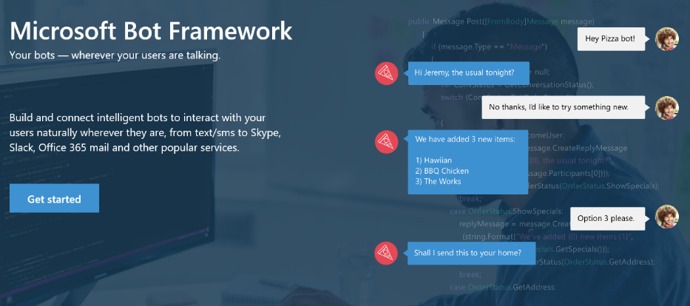
Your bots – wherever your users converse
Intelligence
Cognitive Services
Bot Framework
Cortana
Bot Connector Service: A service to register your bot, configure channels and publish to the Bot Directory. Connect your bot(s) seamlessly to text/sms, Office 365 mail, Skype, Slack, Twitter, and more.
Bot Builder SDK: An open source SDK hosted on GitHub. Everything you need to build great dialogs within your Node.js or C# bot
Bot Directory: A public directory of bots registered through the Bot Connector Service. Discover, try, and add bots to conversation experiences
Notes:
Microsoft Bot Framework enables organizations to build intelligent agents (Bots) that allow your intelligent systems to interact with your users in more contextual and natural ways, from text/sms to Office365 mail to Skype, Slack and other services. The Bot Framework provides developers with a developer portal & SDK to build your bot, a bot connector service to connect to social channels such as Twitter, Slack etc. and a bot directory to discover and use existing bots.
T: Next, Cortana.

Slide 27

Get things done in more helpful, proactive and natural ways
Here are some of the things I can help you with…
Cortana for Consumers (today)
With the Cortana Intelligence Suite
Intelligence
Cognitive Services
Answers
Public reference data answers – “How far is it from Los Angeles to San Francisco?”
Answers from organizational data in Power BI
“What were our biggest deals that closed last month?”
Bot Framework
Predictions
Event predictions – “Who do you think is going to win the Germany Italy game?”
Integration with prediction solutions
“Which of our customers are most likely to churn in the next quarter?”
Cortana
Monitoring & Alerts
Flight status, traffic conditions, changes in weather, …
Monitoring KPIs and preemptive alerting
“Alert me if this customer ever has a 90% chance of churn in the next 30 days”
Task Completion
Setting reminders, scheduling meetings, getting directions, …
Line of business process integration
Assistance with expense report submission on-time within policy
Notes:
The Cortana Intelligence Suite integrates with Cortana, Microsoft’s digital personal assistant. Cortana works with the suite to enable your business, and or your customers business, to get things done in more helpful, proactive, and natural ways. Building on years of Microsoft’s research and innovation in perceptual intelligence including speech recognition, natural user interaction, predictive and advanced analytics, Cortana brings the capabilities of a personal digital assistant to business.
T: Next, we’ll look at how all of this information can be surfaced to those in your business who need it, and to your customers.

Slide 28
Dashboards & Visualizations
Information Management
Big Data Stores
Machine Learning and Analytics
Intelligence
Data Sources
Data Factory
Data Lake Store
Machine Learning
Cognitive Services
Data Catalog
SQL Data
Warehouse
Data Lake Analytics
Bot Framework
Apps
HDInsight
(Hadoop and Spark)
Event Hubs
Cortana
Sensors and devices
Stream Analytics
Dashboards & Visualizations
Power BI
Data
Data
Intelligence
Notes:
Many of the services we’ve been talking about today are on the back-end. But your data and the results of analytics are only useful if they can be provided to those who need them – often people without deep data expertise.
That’s where Power BI comes in. Power BI is a cloud-based dashboard and visualization service that provides faster time to insight. It is used for visualizing, exploring and extracting insights from data. It brings together data from diverse sources to deliver rich, comprehensive views of your business. With Power BI, you can see all of your data in one place and share reports. Live dashboards and reports show visualizations and KPIs from data that reside both on-premises and in the cloud, providing a consolidated view across your business regardless of where your data lives.
T: Now that we’ve walked through everything, let’s take a look at the whole picture.

Slide 29
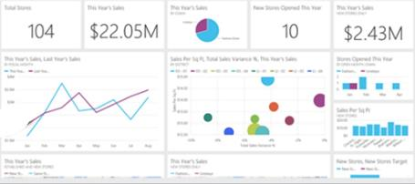
Keep a pulse on your business with live, interactive dashboards
Stream Analytics
Event Hubs
Power BI
Machine Learning
Storage
Power BI
Dashboards & Visualizations
SQL database
Power BI
HDInsight
Power BI
Analytics for everyone, even non-data experts
Your whole business on one dashboard
Create stunning, interactive reports
Drive consistent analysis across your organization
Embed visuals in your applications
Get real-time alerts when things change
Notes:
Many of the services we’ve been talking about today are on the back-end. But your data and the results of analytics are only useful if they can be provided to those who need them – often people without deep data expertise.
That’s where Power BI comes in. Power BI is a cloud-based dashboard and visualization service that provides faster time to insight. It is used for visualizing, exploring and extracting insights from data. It brings together data from diverse sources to deliver rich, comprehensive views of your business. With Power BI, you can see all of your data in one place and share reports. Live dashboards and reports show visualizations and KPIs from data that reside both on-premises and in the cloud, providing a consolidated view across your business regardless of where your data lives.
T: Now that we’ve walked through everything, let’s take a look at the whole picture.

Slide 30
Transform data into intelligent action
Information Management
Big Data Stores
Machine Learning and Analytics
Intelligence
People
Data Sources
Data Factory
Data Lake Store
Machine Learning
Cognitive Services
Data Catalog
SQL Data
Warehouse
Data Lake Analytics
Bot Framework
Web
Apps
HDInsight
(Hadoop and Spark)
Mobile
Event Hubs
Cortana
Apps
Bots
Sensors and devices
Stream Analytics
Dashboards & Visualizations
Automated Systems
Power BI
Data
Data
Intelligence
Action
Notes:
T: Cortana Intelligence provides everything you need to transform your organization’s data into intelligent action. Next, let’s take a look at another demo.

Slide 31
Demo: Vehicle health and driving behavior patterns
Notes:
Connected Cars – Auto industry, TDM audience, Vehicle Telemetry scenario http://infopedia/docstore/pages/kcdoc.aspx?k=KC02-23-79559

Slide 32
Turning telemetry data from vehicles into insight
75%
of the cars shipped globally by 2020 will be built with the necessary hardware to connect to the Internet
So what can we do with that data?
Vehicle diagnostic
What parts need maintenance first on all Ford F-150’s sold?
Roadside
assistance
Fleet management
Show me the location of all vehicles within 50mi of my location
Engine emission control
What is the emissions status of vehicle B204?
Eco-driving
How does the reported MPG compare to actual MPG?
Engine performance remapping
What parts of the engine are not meeting requirements?
Usage-based insurance
Are there any vehicles below the insurance price break threshold?
Notes:
75% of the cars shipped globally by 2020 will be built with the necessary hardware to connect to the Internet.
What does this mean? What can we can do with that data? How can this business leverage the huge amounts of data now available?
There are some questions on this slide, such as “What parts need maintenance first on all Ford F-150’s sold?” that Cortana Intelligence can answer using streaming data from cars strategically.

Slide 33
Example of Cortana Intelligence Suite in action
Data Sources
Ingest
Prepare
Analyze
Publish
Consume
Machine Learning
Power BI
Diagnostic Streaming
Event
Hubs
Sensors and devices
Stream Analytics
Stream Analytics
Machine Learning
HDInsight
Cortana
HDInsight
SQL Data
Warehouse
Business apps
Azure Blob storage
Data Factory: Move data, orchestrate, schedule and monitor
Enterprise
data sources
Data Catalog: Register, annotate, understand, discover data sets
Notes:
Note that this is an example with cars, but it can be insights on any connected devices.
Event Hubs is used to ingest millions of events in real-time. Sensor data from engines, brakes, emissions are ingested and then made accessible for processing.
Stream Analytics is then applied in two key functions:
first to process real-time aggregations on the data and
spool data into long term storage for batch
Machine Learning is used in real-time for anomaly detection on tire pressure, oil level, engine temp, etc to predict vehicles requiring maintenance
Data in BLOB storage is used for rich analytics using HDInsight, orchestrated by Data Factory – allowing us to determine trends like aggressive driving analysis over the past year.
T: Questions like those we looked at can be answered just as simply.

Slide 34
With Cortana Intelligence, better predict needs and trends
Vehicle diagnostic
The front brakes are needing to be serviced sooner than expected
Roadside assistance
Tow truck is on its way to vehicle B204
Fleet management
24 vehicles are shown on a map, showing status
Engine emission control
Vehicle B204 is driving in eco-mode 78% of the time
Eco-driving
14/15 vehicles meet standards and 1 is scheduled for maintenance
Engine performance
Temperature is beyond the ideal range for 13 vehicles
Usage-based insurance
3 vehicles have daily mileage that qualify them for reduced rates
Notes:
Cortana Intelligence can provide answers in real time to complex questions that previously took much longer to answer. Some examples are:
Vehicle diagnostic
“What parts need maintenance first on all Ford F-150’s sold?”
The front brakes are needing to be serviced sooner than expected
Fleet management
“Show me the location of all vehicles within 50mi of my location”
24 vehicles are shown on a map, showing status

Slide 35
Customer stories

Slide 36


Improve visibility and make accurate predictions
Dartmouth-Hitchcock revolutionizes personalized healthcare
Scenario | Static treatment plans | Outdated, generic data
Solution | ImagineCare collects and analyzes real-time and historical data from across devices and records, then surfaces metrics in clinical dashboards and mobile apps for a consumer-focused, personalized treatment plan.
Result | Empowered, healthier patients with personalized, evidence-based treatment plans The ability to identify issues like heart attacks before they happen Millions of dollars saved in readmission costs, unnecessary ER and doctor visits, and less missed work Improved quality of life with 360° views of patient health More effective population health management
“This system is really transforming how we can deliver health and wellness to the population. Despite all of the technology involved, ImagineCare does not lose that human touch, which is so important.”
Nathan Larson, Director of Remote Medical Sensing
Notes:
We are working with Dartmouth-Hitchcock Medical Center to develop a remote monitoring and predictive analytics solution to lower re-admittance rates called “ImagineCare.”
The largest hospital in northern New England, Dartmouth-Hitchcock had static treatment plans and only access to historic and generic data.
To solve this, they are creating highly personalized care “pathways” or treatment plans. Dartmouth-Hitchcock Medical Center is implementing ImagineCare, a consumer-focused treatment model based on Cortana Intelligence Suite and Microsoft Dynamics CRM. ImagineCare connects cloud-based machine learning and analytics with real-time data from medical and health devices including blood pressure monitors, pulse OX devices, and Microsoft Band, along with historical information from sources like electronic health records systems.
The result is a dynamic and contextual care plan that is based on the individual patient’s history and profile. It is infinitely more customized—and definitely more accurate—than traditional plans, which are often based on decades-old data and population averages.
ImagineCare aims to significantly enhance patient outcomes by predicting catastrophic events such as heart attacks before they happen. It will also reduce the number of “readmissions” because each patient will be proactively monitored and Dartmouth-Hitchcock can contact the patient with tweaks/recommendations to the individual’s pathway based on the data collected.
Benefits include:
Empowered, healthier patients with personalized, evidence-based treatment plans based on their data and data from similar health profiles.
Millions of dollars saved in readmission costs, unnecessary ER and doctor visits, and missed work
Improved quality of life with 360-degree view of patient health, mood, and behavior
More effective population health management

Slide 37
Dartmouth-Hitchcock Demo + Video
Notes:
Video: https://youtu.be/x1XARd8Xo7M
Demo assets: http://infopedia/SMSG/Pages/MDWHadoop.aspx?ebookNode=Hadoop&SourceURL=http://infopedia/Pages/SQL-Server-ModernDataWarehouse.aspx

Slide 38


Get the right products to the right places
“With Azure Machine Learning, the wow factor is huge. Customers are amazed that we can predict so accurately what they need.”
Mushtaque Ahmed, COO, JJ Food Service
JJ Food Service optimizes their supply chain
Scenario | Outdated legacy systems | Manual processes | Lack of supply chain visibility
Solution | Dynamic AX end-to-end with Azure Machine Learning analyzing real-time and historical customer data to create predictive shopping lists and provide product recommendations based on cart contents
Result | Accurate predictions of customers’ needs IoT-enabled cab sensors Arrival of foods in peak condition Increase in basket value through upsell with decreased checkout times
Notes:
JJ Food Service’s business model has changed from one where they have a personal relationship by phone with their customers to one where they are ordering from a portal.
With outdated systems, manual processes, and lack of supply chain visibility they were lacking the connectivity and ability to help customers find what they really wanted to buy.
JJ Food Service Ltd. looked to technology to optimize their supply chain: Microsoft Dynamics AX + Azure + Azure Machine Learning + Devices. With Machine Learning, customers’ preferences can be mashed up across multiple applications with any number of sources of data. That results in anticipating and fulfilling customers’ needs, even without an actual human interaction. JJ is using Machine Learning to accurately predict what the customer is likely to buy next, and JJ say with just a little intelligence its amazing how helpful they can be to their customer bases through:
Accurate predictions of customers’ needs
IOT-enabled cab sensors
Arrival of foods in peak condition
Increase in basket value through upsell with decreased checkout times
JJ Foods case study (UK) – https://customers.microsoft.com/Pages/CustomerStory.aspx?recid=18352
Another good reference: Wirtz Beverage (US) - http://customers.microsoft.com/Pages/CustomerStory.aspx?recid=10760

Slide 39

JJ Food Service Video
Notes:
Video: https://www.youtube.com/watch?v=q2Ebn9TSK-I
Dynamics version of the video: https://www.youtube.com/watch?v=p5LvCgpqOkY

Slide 40


Offer customers exactly what they want, when they want it
Tangerine instantly adapts to customer feedback
“I can see us…creating predictive, context-aware financial services applications that give information based on the time and where the customer is.”
Billy Lo Head of Enterprise Architecture
Scenario | Lack of insight for targeted campaigns | Inability to support data growth
Solution | Microsoft Analytics Platform System (APS) along with Azure HDInsight (Hadoop-as-a-service) enables instant analysis of social sentiment and customer feedback across digital, face-to-face and phone interactions.
Result | Reduced time to customer insight Ability to make changes to campaigns or adjust product rollouts based on real-time customer reactions Ability to offer incentives and new services to retain—and grow—its customer base
Notes:
<Note: no video or demo associated with this case study yet>
Tangerine faced a lack of market differentiation, insight for targeted campaigns, and the ability to support their data growth.
To address this issue, they decided to deploy the Microsoft Analytics Platform System (APS), a turnkey big data analytics appliance, along with Microsoft Azure HDInsight, the Microsoft cloud Hadoop-as-a-service.
For Tangerine, transforming customer data into insight is now much easier—and faster. Employees can instantly access usable BI analysis and make better decisions in order to offer customers what they want, when they want it, adjusting on the fly.
With a better ability to learn what its customers are looking for, Tangerine can offer the incentives and new services it needs to be able to retain—and grow—its customer base while creating new services and campaigns based on social media data.
Other benefits include:
Reduced time to customer insight
Ability to make changes to campaigns or adjust product rollouts based on real-time customer reactions
Ability to offer incentives and new services to retain—and grow—its customer base
Tangerine case study: https://customers.microsoft.com/Pages/CustomerStory.aspx?recid=14594

Slide 41


Fix problems proactively before they start
“We’re using a lot of different Microsoft Azure technologies, including Azure Machine Learning, but the core solution is to help operators predict issues to prevent blackouts.”
Knut Johansen CEO
eSmart Systems helps utilities prevent power outages
Scenario | Disparate data sources | New technologies like smart meters | Aging grid infrastructure
Solution | A combination of Microsoft Azure technologies, with Azure ML extracting insights from micro-second sensor and smart meter data to predict energy usage patterns and optimize infrastructure maintenance
Result | Improved grid management with demand forecasting Optimized UIs to help utilities better manage their data The ability to integrate new energy sources and technologies Cost savings from moving load to off-peak hours
Notes:
eSmart Systems helps the lights stay on by creating next-generation, smart-grid software that optimizes the exchange of energy and data.
This requires pulling all kinds of disparate data together, which can be a challenge. On top of that, the utilities customers they serve are looking to get more value out of the data they have, especially as they invest in technology like smart sensors and meters that can improve efficiency.
eSmart is addressing these needs by turning to the Microsoft Azure cloud platform, and using Azure Machine Learning (ML) as the brains of the modern smart grid.
They designed an automated demand response solution that collects data from virtually any type of meter or sensor. It then runs predictive models in Azure ML to forecast potential capacity problems and automatically control load to buildings or other infrastructure to prevent outages. Data is collected from smart sensors and meters in Azure Storage blobs, and then run through predictive models on Azure ML. Next, the information is analyzed on a Hadoop cluster with Azure HDInsight for a closer look at usage. eSmart provides access to the data in several ways. For example, the data is either visualized by grid operators through an interface created by eSmart, or made more widely available to business users through interactive Microsoft Power BI dashboards. Power BI provides the additional advantage of on-the-fly, custom analytics. Initially focused on demand response management, the company plans to extend its solution to include predictive maintenance. By taking advantage of Microsoft cloud services, the eSmart System Platform can easily optimize virtually any energy management scenario, such as specialized deployments for commercial buildings and electric vehicles.
Benefits of this solution include:
Improved grid management with demand forecasting
Optimized UIs to help utilities better manage their data
The ability to integrate new energy sources and technologies
Cost savings from moving load to off-peak hours, and avoidance of costly investment in both grid and IT infrastructure
Utilities try to stretch their investment by moving some of the load from peak to off-peak hours, because it’s costly to upgrade the grid. Using the eSmart energy management platform based on Azure, utilities can cut peak hours, avoid upgrades, and save a lot of money.
eSmart Systems case study: https://customers.microsoft.com/Pages/CustomerStory.aspx?recid=18945

Slide 42

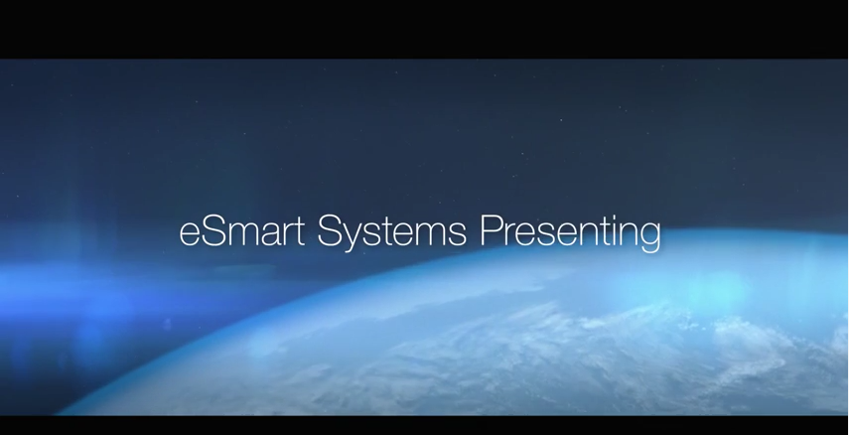
eSmart Systems Video
Notes:
Video: https://www.youtube.com/watch?v=iAxNtJVwcrE

Slide 43


Explore new business opportunities
“We wanted to go beyond the industry standard of preventative maintenance, to offer predictive and even preemptive maintenance.”
Andreas Schierenbeck CEO, ThyssenKrupp Elevator
ThyssenKrupp Elevator develops new services capabilities
Scenario | Variable elevator uptime | The need for competitive differentiation
Solution | Several Azure technologies, including Machine Learning, that enable monitoring via a real-time dashboard and that instruct technicians on optimal maintenance activities through dynamic predictive models
Result | Increased elevator uptime Reduced costs for ThyssenKrupp and its customers Rich, real-time data visualization and awareness of issues The ability offer predictive maintenance services for customers around the globe
Notes:
Elevator manufacturer ThyssenKrupp wanted to gain a competitive edge by focusing on what matters most to its customers in buildings the world over: reliability.
By connecting its elevators to the cloud, gathering data from its sensors and systems, and transforming that data into valuable business intelligence, ThyssenKrupp is vastly improving operations, and offering something its competitors do not: predictive and even preemptive maintenance.
ThyssenKrupp developed a connected asset monitoring system that securely connects thousands of sensors and systems to the cloud. ThyssenKrupp can now monitor everything from motor temperature to shaft alignment, cab speed to door functioning and extract insights to help address downtime and improve reliability. Its solution captures data, transmits it into the cloud and combines it into a single dashboard that serves up two basic types of data: alarms that indicate an immediate issue, and events, which are stored and used for management. The solution provides technicians with instant diagnostic capabilities and rich, real-time data visualization.
With this data and insight, ThyssenKrupp has the foundation required to offer a new class of maintenance services along with their elevators, expanding their value proposition to their customers, both new and existing.
With Microsoft Azure Machine Learning (Azure ML) service, ThyssenKrupp has an unprecedented view into elevator operations and maintenance, now and in the future. The system contains an intelligent information loop: Data from elevators is fed into dynamic predictive models, which continually update datasets via seamless integration with Azure. Now, the elevators can actually teach technicians how to fix them. With up to 400 error codes possible on any given elevator, that can significantly sharpen efficiency in the field, resulting in dramatically increased elevator uptime.
ThyssenKrupp case study: https://www.microsoft.com/en-us/server-cloud/customer-stories/thyssen-krupp-elevator.aspx

Slide 44

ThyssenKrupp Demo + Video
Notes:
Video:
Public URL: https://www.youtube.com/watch?v=jhrhBgZphBw
Internal URL: https://microsoft.sharepoint.com/sites/academy/media/Catalog/AEVD-3-99448
Additional demo assets:
Internal: https://microsoft.sharepoint.com/sites/Infopedia_G05KC/Pages/Custom/ThyssenkruppDemo.aspx
Public: https://readytogo.microsoft.com/global/_layouts/RTG/AssetViewer.aspx?AssetUrl=https%3a%2f%2freadytogo.microsoft.com%2fglobal%2fAsset%2fPages%2fTKE%20Demo.aspx

Slide 45
Explore Cortana Intelligence today
1. Learn more
Keep up on the latest cloud-based analytics news on our blog ▶
2. Get trained
3. Find or become a partner
Watch the Cortana Intelligence Workshop ▶
Connect with a partner who can help tailor Cortana Intelligence to your needs ▶
Visit the Cortana Intelligence page ▶
Participate in Data Science and Machine Learning Essentials course through edX ▶
Become a Cortana Intelligence Partner ▶
Notes:
Here a few things you can do today.
We have also created a lot of trainings so that you can better understand the product and how it can help your company
As far as partners, we have a large network that is ready and able to help tailer the suite and its functions to your needs
If you are interested in becoming a partner, follow the link on this slide and we will be in touch
IF SHOWING VIDEO: I’d like to end on a short video showing one more great example using Cortana Intelligence
Thank you all for attending.

Slide 46

© 2016 Microsoft Corporation. All rights reserved.
Notes:
Thanks for your time.

Slide 47
Appendix

Slide 48

Video: American Eagle
WATCH VIDEO
WATCH VIDEO
Notes:
https://www.youtube.com/watch?v=YxmAEMmwXYU

Slide 49

Think about a really big data problem

Slide 50
Tough Love for Microsoft Search
Danny Sullivan, Search Engine Land December 30, 2008
Google wasn’t just a brand, it was a habit
bing comes from behind

Slide 51

Processing hundreds of billions of documents
Understanding billions of entities
Reasoning trillions of entity relationships
Search is a big data play
Seeing hundreds of billions of queries and clicks
Serving and adapting for billions of users

Slide 52




Microsoft had a sliding US search share 2005-2009
70%
60%
50%
40%
30%
20%
10%
Oct
2005
Jan
2006
April
2006
July
2006
Oct
2006
Jan
2007
April
2007
July
2007
Oct
2007
Jan
2008
April
2008
July
2008
Oct
2008
Jan
2009
April
2009
July
2009

Slide 53
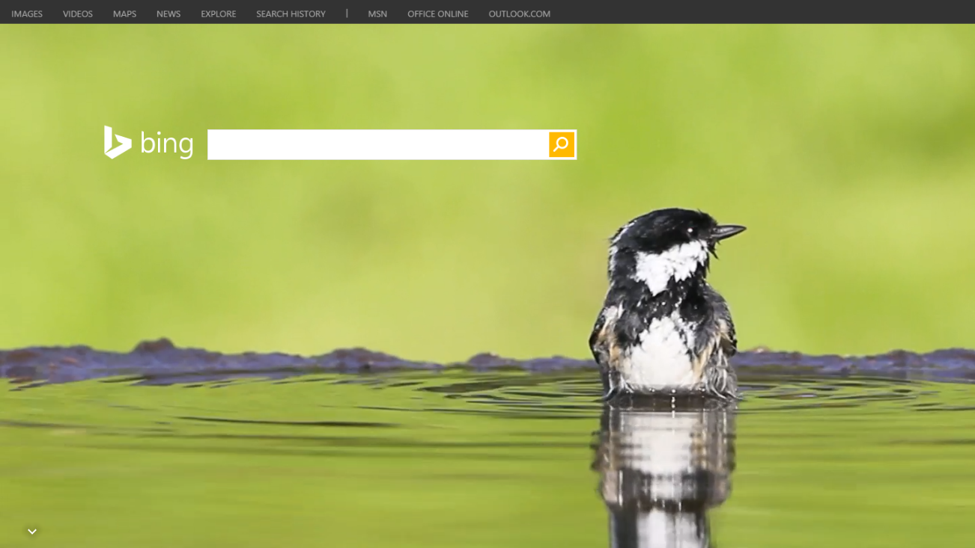
?
Why

Slide 54
Hard to hire data scientists
Lots of people involved need access to data
Organizationally, it’s a hard problem too
Huge technical integration challenges
Massive volume, velocity, and variety of data

Slide 55
Qi Lu was brought on board—a new perspective
Laser focused on measuring relevance (NDCG)
So, what did we do differently?
Measure the rate of exploration (count of experiments)
Empower everyone to explore (100x people)

Slide 56

Built an exabyte-scale data lake for everyone to put their data of all types (structured and unstructured)
Infrastructure investments are risky
Built tools approachable by any developer
Built machine learning tools for collaborating across large experiment models

Slide 57
Microsoft doubles search share
Source: ComScore 2009-2015 Search Report US

Slide 58
We went through these learnings
It is a hard problem
Where does this leave you?
It requires a lot of investment and know-how to get it right
With Cortana Analytics, you don’t have to be the size of Bing to solve the problem

